Slide 1

Date: 2012/07/02
Source: Marina Drosou, Evaggelia Pitoura (CIKM’11) Speaker: Er-Gang Liu
Advisor: Dr. Jia-ling Koh

Slide 2
Outline
Introduction
The ReDRIVE framework
  FaSets
  Interesting faSets
Top-k faSets computation
  Recommendations Statistics maintenance
  Two-Phase algorithm
Experiment
Conclusion

Slide 3
Outline
Introduction
The ReDRIVE framework
    FaSets
    Interesting faSets
Top-k faSets computation
    Recommendation Statistics maintenance
    Two-Phase algorithm
Experiment
Conclusion

Slide 4


Introduction - Motivation
User
Database
(EX：IMDB)
Query search
    Not knowing the exact content of the database

Slide 5
Introduction - Motivation
Show me movies directed by F.F. Coppola
Query Result
Director | Title | Year | Genre
F.F. Coppola | Tetro | 2009 | Drama
F.F. Coppola | Youth Without Youth | 2007 | Fantasy
F.F. Coppola | The Godfather | 1972 | Drama
F.F. Coppola | Rumble Fish | 1983 | Drama
F.F. Coppola | The Conversation | 1974 | Thriller
F.F. Coppola | The Outsiders | 1983 | Drama
F.F. Coppola | Supernova | 2000 | Thriller
F.F. Coppola | Apocalypse Now | 1979 | Drama
    No clear understanding of information needs
Users interact with databases by formulating queries

Slide 6
Introduction - Goal
1
Query
2
Query Result
SELECT title, year, genre
FROM movies, directors, genres
WHERE director = ‘F.F. Coppola’ AND join(Q)
Director | Title | Year | Genre
F.F. Coppola | Tetro | 2009 | Drama
F.F. Coppola | Youth Without Youth | 2007 | Fantasy
F.F. Coppola | The Godfather | 1972 | Drama
F.F. Coppola | Rumble Fish | 1983 | Drama
F.F. Coppola | The Conversation | 1974 | Thriller
F.F. Coppola | The Outsiders | 1983 | Drama
F.F. Coppola | Supernova | 2000 | Thriller
F.F. Coppola | Apocalypse Now | 1979 | Drama
3
Recommendation
Recommendation
Drama
Drama , 2009
Drama , 1983
Thriller
Thriller , 1974
Fantasy
Fantasy , 2007
Fantasy , 2007 , Youth Without Youth
Interesting faSet
4
Explorator Query
SELECT director
FROM movies, directors, genres
WHERE year = 1983 AND genre = ‘Drama’ AND join(Q)

Slide 7
Outline
Introduction
The ReDRIVE framework
    FaSets
    Interesting faSets
Top-k faSets computation
    Recommendation Statistics maintenance
    Two-Phase algorithm
Experiment
Conclusion

Slide 8
FaSets
Facet condition:
    A condition A_{i} = a_{i} on some attribute of Res(Q)
m-FaSet:
    A set of m facet conditions on m different attributes of Res(Q)
Director | Title | Year | Genre
F.F. Coppola | Tetro | 2009 | Drama
F.F. Coppola | Youth Without Youth | 2007 | Fantasy
F.F. Coppola | The Godfather | 1972 | Drama
F.F. Coppola | Rumble Fish | 1983 | Drama
F.F. Coppola | The Conversation | 1974 | Thriller
F.F. Coppola | The Outsiders | 1983 | Drama
F.F. Coppola | Supernova | 2000 | Thriller
F.F. Coppola | Apocalypse Now | 1979 | Drama
1-faSet
2-faSet

Slide 9





Interestingness score of a FaSet
Support of f in Res(Q)
Support of f in the database
Score ( f , Q = “F.F. Coppola” )
DB
Query Result
Director | Title | Year | Genre
F.F. Coppola | Tetro | 2009 | Drama
F.F. Coppola | Youth Without Youth | 2007 | Fantasy
F.F. Coppola | The Godfather | 1972 | Drama
F.F. Coppola | Rumble Fish | 1983 | Drama
F.F. Coppola | The Conversation | 1974 | Thriller
F.F. Coppola | The Outsiders | 1983 | Drama
F.F. Coppola | Supernova | 2000 | Thriller
F.F. Coppola | Apocalypse Now | 1979 | Drama
P (“Drama” | Res(Q)) = $\frac{5}{8}$
= 125
P (“Drama” | D)) = $\frac{50}{10000}$
All tuple: 10000
P (“Thriller” | Res(Q)) = $\frac{2}{8}$
“Drama” : 50
= 500
“Thriller” : 5
P (“Thriller” | D) = $\frac{5}{10000}$

Slide 10
Outline
Introduction
The ReDRIVE framework
    FaSets
    Interesting faSets
Top-k faSets computation
    Recommendation Statistics maintenance
    Two-Phase algorithm
Experiment
Conclusion

Slide 11
Top-k faSets computation
To compute the interestingness score of a faSet :
  p(f |Res(Q))
  p(f |D)
p(f |Res(Q)) is computed on-line
p(f |D) is too expensive ⇒ must be estimated
  Compute off-line and store statistics that will allow us to estimate p(f |D) for any faSet f.
FaSets that appear frequently in the database D are not expected to be interesting.

Slide 12
Estimating p(f |D)
It is useful to maintain information about the support of
“rare faSets” in D.
In correspondence to Data Mining, paper define:
  Rare faSet (RF) : A faSet with frequency under a threshold
  Closed Rare faSet (CRF) : A rare faSet with no proper subset with the same frequency
  Minimal Rare faSet (MRF) : A rare faSet with no rare subset
|MRFs| ≤ |CRFs| ≤ |RFs|
MRFs can tell us if f is rare but not its frequency
CRFs can tell us its frequency but are still too many

Slide 14
  Minimal Rare faSet (MRF) :
  A rare faSet with no rare subset
ab :
a,b
acd:
ac,ad,cd
ade:
ad,de,ae
  Rare faSet (RF) : A faSet with frequency under a threshold

Slide 15
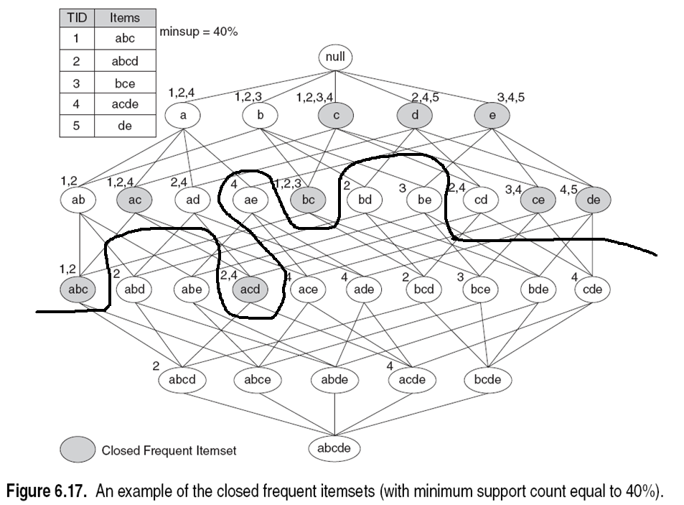
  Closed Rare faSet (CRF) :
  A rare faSet with no proper subset with the same frequency
abd(1) :
ab(2) , ad(2) , bd(2)
bde(0):
bd(1),be(1),de(2)
bcde(0):
bcd(1),bce(1),
bde(0),cde(1)
Not Closed Rare faSet

Slide 16
Statistics
Maintaining statistics in the form of 𝜀-Tolerance Closed Rare FaSets (𝜀-CRFs):
A faSet f is an 𝜀-CRF for a set of tuples S if and only if:
  it is rare for S
  it has no proper rare subset f’, |f’ |=|f |-1, such that:
    count(f’,S) < (1+ 𝜀)count(f,S), 𝜀 ≥ 0

Slide 17
Outline
Introduction
The ReDRIVE framework
    FaSets
    Interesting faSets
Top-k faSets computation
    Recommendation Statistics maintenance
    Two-Phase algorithm
Experiment
Conclusion

Slide 18
The Two-Phase Algorithm (1/3)
Maintain all 𝜀-CRFs, where rare is defined by minsupp_{r}
First Phase:
  X = {all 1-faSets in Res(Q)}
  Y = {𝜀-CRFs that consist only of 1-faSets in X}
Query Result
X
Collection of
maintained Statistics
Y
Director | Title | Year | Genre
F.F. Coppola | Tetro | 2009 | Drama
F.F. Coppola | Youth Without Youth | 2007 | Fantasy
F.F. Coppola | The Godfather | 1972 | Drama
F.F. Coppola | Rumble Fish | 1983 | Drama
F.F. Coppola | The Conversation | 1974 | Thriller
F.F. Coppola | The Outsiders | 1983 | Drama
F.F. Coppola | Supernova | 2000 | Thriller
F.F. Coppola | Apocalypse Now | 1979 | Drama
1-faSet
Drama
Fantasy
Thriller
2009
2007
1972
𝜀-CRFs
Drama : 50
Thriller : 5
Drama
Thiller
2007
.
.
.
.
.
.
.
.

Slide 19
The Two-Phase Algorithm (2/3)
Maintain all 𝜀-CRFs, where rare is defined by minsupp_{r}
First Phase:
  Y = {𝜀-CRFs that consist only of 1-faSets in X}
  Z = {faSets in Res(Q) that are supersets of some faSet in Y}
    Compute scores for faSets in Z
Query Result
Y
Z
Director | Title | Year | Genre
F.F. Coppola | Tetro | 2009 | Drama
F.F. Coppola | Supernova | 2000 | Thriller
Drama
Thiller
2007
{ 2009, Drama }
{ Tetro, 2009, Drama }
{ 2000, Thriller}
{Supernova , 2000, Thriller }
.
.
.
.
.
.
.
.
{ 2009, Drama }
{ Tetro, 2009, Drama }
{ 2000, Thriller}
{Supernova , 2000, Thriller }

Slide 20
The Two-Phase Algorithm (3/3)
Let f be a faSet examined in the second phase. This means that p(f |D) > minsupp_{r}
Second Phase:
  Reset the threshold minsupp_{f} by minsupp_{r}
  Executing a frequent itemset mining algorithm (A-priori) with threshold minsupp_{f} = s * minsupp_{r}
    (s = k^{th} highest score in Z )
“frequent itemset” and
    “p(f |Res(Q)) > minsupp_{f}”
Query Result
Top K
Director | Title | Year | Genre
F.F. Coppola | Tetro | 2009 | Drama
F.F. Coppola | Youth Without Youth | 2007 | Fantasy
F.F. Coppola | The Godfather | 1972 | Drama
F.F. Coppola | Rumble Fish | 1983 | Drama
F.F. Coppola | The Conversation | 1974 | Thriller
F.F. Coppola | The Outsiders | 1983 | Drama
F.F. Coppola | Supernova | 2000 | Thriller
F.F. Coppola | Apocalypse Now | 1979 | Drama
{ 2009, Drama }
{ Tetro, 2009, Drama }
{ 2000, Thriller}
{Supernova , 2000, Thriller }
.
.

Slide 21
Outline
Introduction
The ReDRIVE framework
    FaSets
    Interesting faSets
Top-k faSets computation
    Recommendation Statistics maintenance
    Two-Phase algorithm
Experiment
Conclusion

Slide 22
Experiment - Datasets
Experimenting using real datasets:
  AUTOS: single-relation, 15191 tuples, 41 attributes
  MOVIES: 13 relations, 10,000 ~ 1,000,000 tuples, 2～5 attributes
And synthetic ones:
  ZIPF: single relation, 1000 tuples, 5 attributes

Slide 23
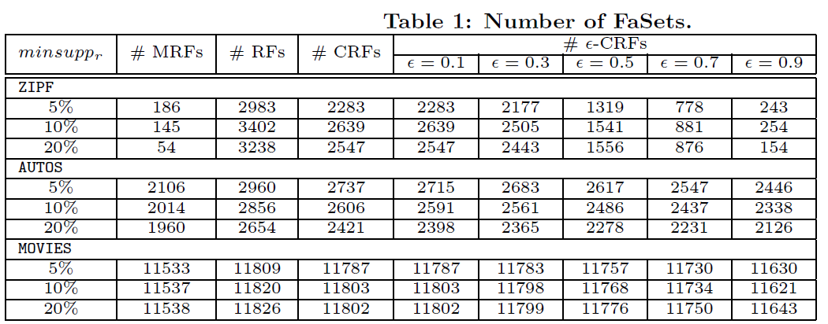
Experiment Generation

Slide 24
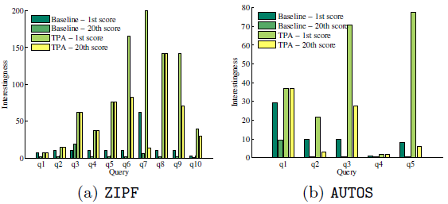
Top-k faSets discovery
  Baseline: Consider only frequent faSets in Res(Q)
  TPA: Two-Phase Algorithm

Slide 25
Conclusion
Introducing ReDRIVE, a novel database exploration framework for recommending to users items which may be of interest to them although not part of the results of their original query
Proposing a frequency estimation method based on 𝜀-CRFs
Proposing a Two-Phase Algorithm for locating the top-k most interesting faSets

Slide 26
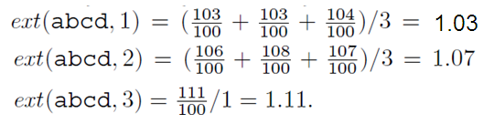
δ= 0.04
“abcd” is the closest δ-TCFI superset of all its subsets that contain the item “a”
“bcd” is the closest δ-TCFI superset of “bc”, “cd” and “c”
let Y = abcd, then
X1 = {abc, abd, acd}, X2 = {ab, ac, ad} and X3 = {a}.

Slide 27
the frequency of “abc”, “abd” , “acd” are estimated
: (freq(abcd)・ext(abcd, 1)) = 100 * 1.03 = 103,
the frequency of “ab”, “ac” , “ad” are estimated :
: (freq(abcd)・ext (abcd, 2)) = 107
frequency of “a” is estimated
: (freq(abcd)・ ext(abcd, 3)) = 111

